Slide 1
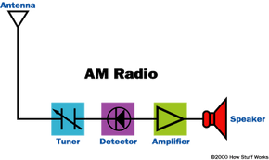
AM ( Amplitude Modulation )
Presented by Foysal HUsain

Slide 2

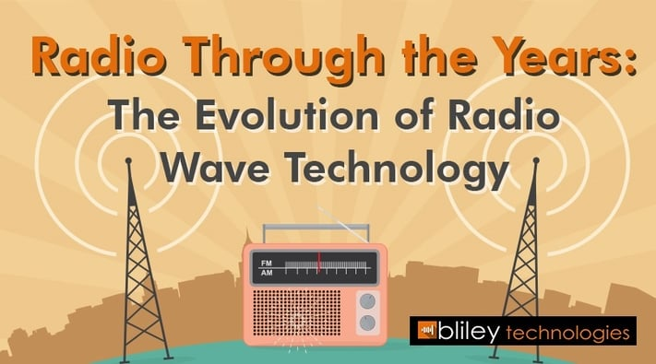
AM is radio broadcasting using amplitude modulation to communicate all aspect of radio, such as music, all news and radio talk.
It was created first by Am developer Reginald Fessenden in 1906.
There 6000 AM radio station in US today. It is use globally in countries like Canada, Australia, and Japan etc.

Slide 3

functionality of AM radio
people listen most AM radio in their Vehicle for music, news, wheatear, and traffic.

Slide 4
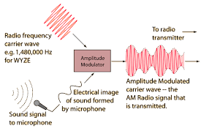
How Am Works
AM receiver catches amplitude variations in the radio waves at a certain frequency, then amplifies changes in the signals voltages to controls a loudspeakers or earphone.

Slide 5
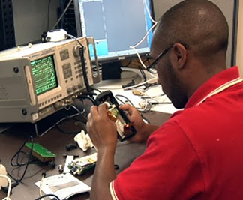


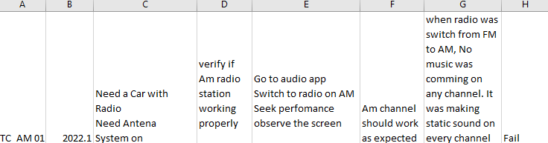

Slide 6

Software Performance Report In software performance life cycle, we perform software test to make sure it is bug/defect free and meets all requirements. While performing the test if I detect any bug, I will create a bug report. In the bug report I will include following items such as test step I took to come across the bug, how many time I performed the test, and how many occurrence there was. I will include any pictures , screenshot and video of the testing. Also, I will add the full description of performing the test and how I came along the bug.

Slide 7


